Slide 1
DCIT 204 Data Structures and Algorithms 1
Session 1 - Introduction
Course Writer: Dr Kofi Sarpong Adu-Manu
Contact Information: ksadu-manu@ug.edu.gh

Slide 2
Data structures
A data structure is a way of organizing, storing, and performing operations on data.

Slide 3
Basic data structures.
Data structure | Description
Record | A record is the data structure that stores subitems, often called fields, with a name associated with each subitem.
Array | An array is a data structure that stores an ordered list of items, where each item is directly accessible by a positional index.
Linked list | A linked list is a data structure that stores an ordered list of items in nodes, where each node stores data and has a pointer to the next node.
Binary tree | A binary tree is a data structure in which each node stores data and has up to two children, known as a left child and a right child.
Hash table | A hash table is a data structure that stores unordered items by mapping (or hashing) each item to a location in an array.
Heap | A max-heap is a tree that maintains the simple property that a node's key is greater than or equal to the node's childrens' keys. A min-heap is a tree that maintains the simple property that a node's key is less than or equal to the node's childrens' keys.
Graph | A graph is a data structure for representing connections among items, and consists of vertices connected by edges. A vertex represents an item in a graph. An edge represents a connection between two vertices in a graph.

Slide 4
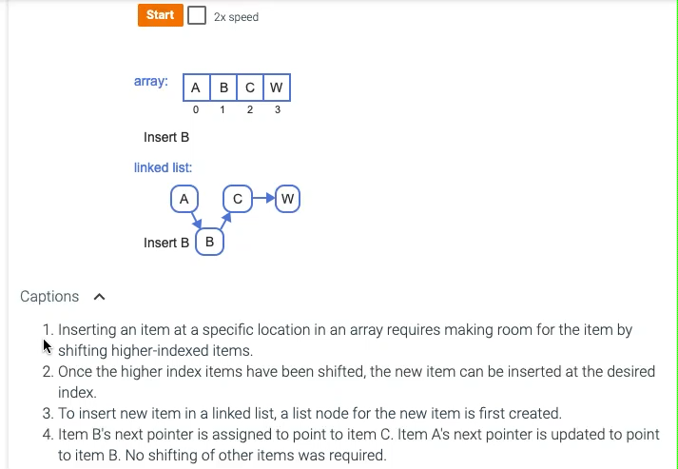
Inserting an Item

Slide 5
What is an algorithm?
An algorithm is a sequence of unambiguous instructions for solving a problem, i.e., for obtaining a required output for any legitimate input in a finite amount of time.
problem
algorithm
“computer”
input
output

Slide 6
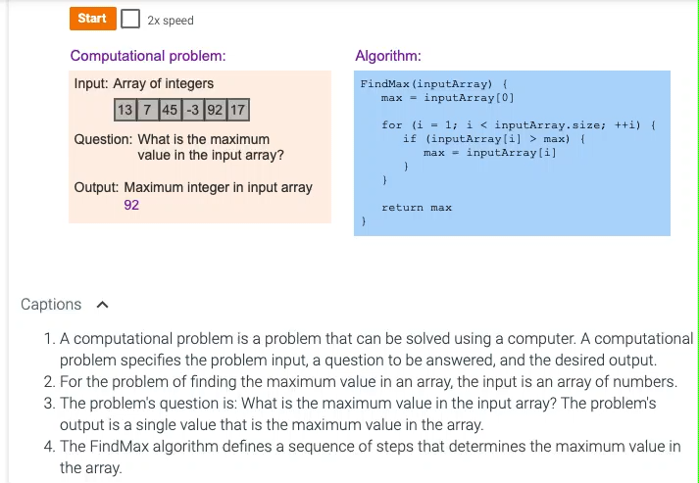
Computational problem
A computational problem specifies an input, a question about the input that can be answered using a computer, and the desired output.

Slide 7
Example computational problems and common algorithms.
Application domain | Computational problem | Common algorithm
DNA analysis | Given two DNA sequences from different individuals, what is the longest shared sequence of nucleotides? | Longest common substring problem: A longest common substring algorithm determines the longest common substring that exists in two input strings. DNA sequences can be represented using strings consisting of the letters A, C, G, and T to represent the four different nucleotides.
Search engines | Given a product ID and a sorted array of all in-stock products, is the product in stock and what is the product's price? | Binary search: The binary search algorithm is an efficient algorithm for searching a list. The list's elements must be sorted and directly accessible (such as an array).
Navigation | Given a user's current location and desired location, what is the fastest route to walk to the destination? | Dijkstra's shortest path: Dijkstra's shortest path algorithm determines the shortest path from a start vertex to each vertex in a graph. The possible routes between two locations can be represented using a graph, where vertices represent specific locations and connecting edges specify the time required to walk between those two locations.

Slide 8
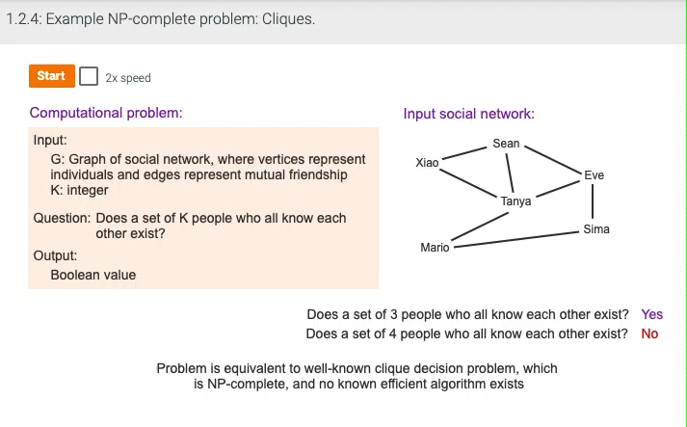
NP-complete
NP-complete problems are a set of problems for which no known efficient algorithm exists.
Notes:
A programmer may be asked to write an algorithm to solve the problem of determining if a set of K people who all know each other exists within a graph of a social network?
For the example social network graph and K = 3, the algorithm should return yes. Xiao, Sean, and Tanya all know each other. Sean, Tanya, and Eve also all know each other.
For K = 4, no set of 4 individual who all know each other exists, and the algorithm, should return no.
This problem is equivalent to the clique decision problem, which is NP-complete, and no known polynomial time algorithm exists.

Slide 9
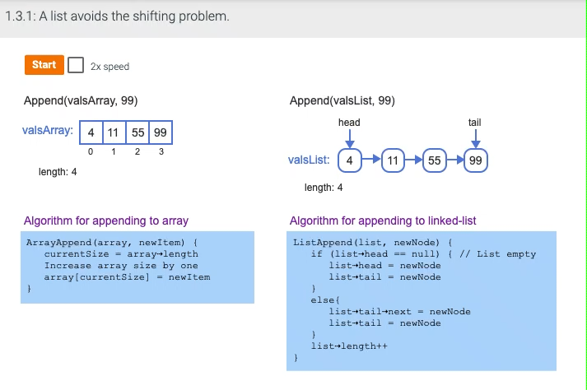
Relation between data structures and algorithms
Notes:
The algorithm to append an item to a linked list points the tail node's next pointer and the list's tail pointer to the new node.
Captions
The algorithm to append an item to an array determines the current size, increases the array size by 1, and assigns the new item as the last array element.
The algorithm to append an item to a linked list points the tail node's next pointer and the list's tail pointer to the new node.

Slide 10
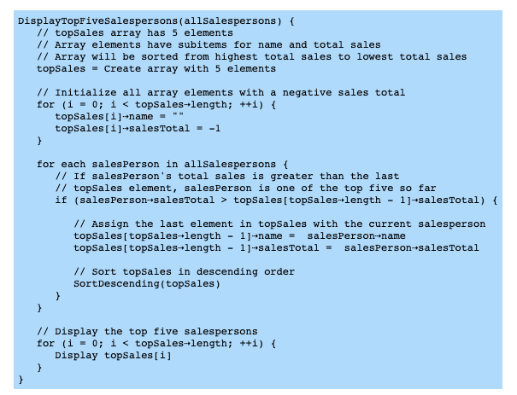
Algorithm to determine the top five salespersons using an array.

Slide 11
Abstract data types
An abstract data type (ADT) is a data type described by predefined user operations, such as "insert data at rear," without indicating how each operation is implemented.
An abstract data type (ADT) is a data type described by predefined user operations, such as "insert data at rear," without indicating how each operation is implemented.

Slide 12
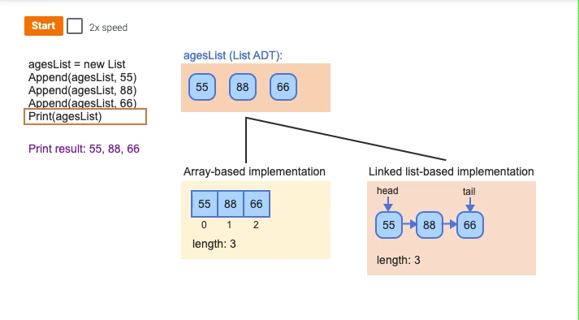
List ADT using array and linked lists data structures.
Notes:
Captions
A new list named agesList is created. Items can be appended to the list. The items are ordered.
Printing the list prints the items in order.
A list ADT is commonly implemented using array and linked list data structures. But, a programmer need not have knowledge of which data structure is used to use the list ADT.

Slide 13
Common ADTs
Abstract data type | Description | Common underlying data structures
List | A list is an ADT for holding ordered data. | Array, linked list
Dynamic array | A dynamic array is an ADT for holding ordered data and allowing indexed access. | Array
Stack | A stack is an ADT in which items are only inserted on or removed from the top of a stack. | Linked list
Queue | A queue is an ADT in which items are inserted at the end of the queue and removed from the front of the queue. | Linked list
Deque | A deque (pronounced "deck" and short for double-ended queue) is an ADT in which items can be inserted and removed at both the front and back. | Linked list
Bag | A bag is an ADT for storing items in which the order does not matter and duplicate items are allowed. | Array, linked list
Set | A set is an ADT for a collection of distinct items. | Binary search tree, hash table
Priority queue | A priority queue is a queue where each item has a priority, and items with higher priority are closer to the front of the queue than items with lower priority. | Heap
Dictionary (Map) | A dictionary is an ADT that associates (or maps) keys with values. | Hash table, binary search tree

Slide 14
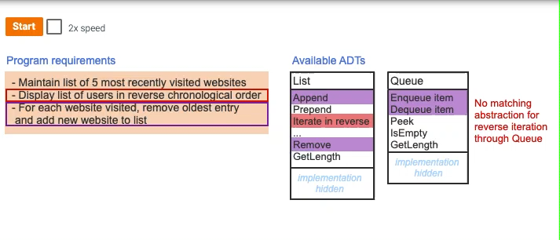
Applications of ADTs
Notes:
Abstraction simplifies programming. ADTs allow programmers to focus on choosing which ADTs best match a program's needs.
Both the List and Queue ADTs support efficient interfaces for removing items from one end (removing oldest entry) and adding items to the other end (adding new entries).
The list ADT supports iterating through list contents in reverse order, but the queue ADT does not.
To use the List (or Queue) ADT, the programmer does not need to know the List's underlying implementation.

Slide 15
Standard libraries in various programming languages.
Programming language | Library | Common supported ADTs
Python | Python standard library | list, set, dict, deque
C++ | Standard template library (STL) | vector, list, deque, queue, stack, set, map
Java | Java collections framework (JCF) | Collection, Set, List, Map, Queue, Deque

Slide 16
Algorithm efficiency
Algorithm efficiency
Algorithm efficiency is typically measured by the algorithm's computational complexity.
Computational complexity
Computational complexity is the amount of resources used by the algorithm.

Slide 17
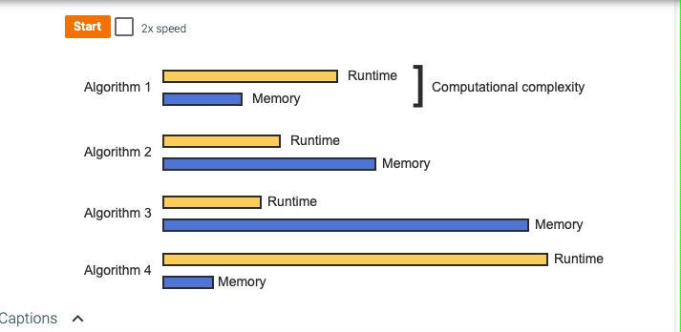
Computational complexity
Notes:
An algorithm's computational complexity includes runtime and memory usage.
Measuring runtime and memory usage allows different algorithms to be compared.
Complexity analysis is used to identify and avoid using algorithms with long runtimes or high memory usage.

Slide 18
Algorithm efficiency
runtime complexity
An algorithm's runtime complexity is a function, T(N), that represents the number of constant time operations performed by the algorithm on an input of size N.
best case
An algorithm's best case is the scenario where the algorithm does the minimum possible number of operations.
worst case
An algorithm's worst case is the scenario where the algorithm does the maximum possible number of operations.

Slide 19
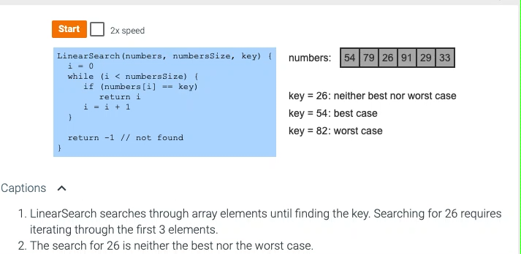
Linear search best and worst cases.
Notes:
LinearSearch searches through array elements until finding the key. Searching for 26 requires iterating through the first 3 elements.
The search for 26 is neither the best nor the worst case.
Searching for 54 only requires one comparison and is the best case: The key is found at the start of the array. No other search could perform fewer operations.
Searching for 82 compares against all array items and is the worst case: The number is not found in the array. No other search could perform more operations.

Slide 20
space complexity
An algorithm's space complexity is a function, S(N), that represents the number of fixed-size memory units used by the algorithm for an input of size N.
auxiliary space complexity
An algorithm's auxiliary space complexity is the space complexity not including the input data.

Slide 21
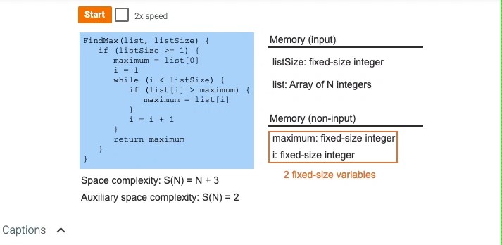
FindMax space complexity and auxiliary space complexity.

Slide 22
Euclid’s Algorithm
Problem: Find gcd(m,n), the greatest common divisor of two nonnegative, not both zero integers m and n
Examples: gcd(60,24) = 12, gcd(60,0) = 60, gcd(0,0) = ?
Euclid’s algorithm is based on repeated application of equality
gcd(m,n) = gcd(n, m mod n)
until the second number becomes 0, which makes the problem
trivial.
Example: gcd(60,24) = gcd(24,12) = gcd(12,0) = 12
Notes:
Euclid’s algorithm is good for introducing the notion of an algorithm because it
makes a clear separation from a program that implements the algorithm.
It is also one that is familiar to most students.
Al Khowarizmi (many spellings possible...) – “algorism” (originally) and then later “algorithm” come from his name.

Slide 23
Two descriptions of Euclid’s algorithm
Step 1 If n = 0, return m and stop; otherwise go to Step 2
Step 2 Divide m by n and assign the value fo the remainder to r
Step 3 Assign the value of n to m and the value of r to n. Go to Step 1.
while n ≠ 0 do
r ← m mod n
m← n
n ← r
return m

Slide 24
Other methods for computing gcd(m,n)
Consecutive integer checking algorithm
Step 1 Assign the value of min{m,n} to t
Step 2 Divide m by t. If the remainder is 0, go to Step 3; otherwise, go to Step 4
Step 3 Divide n by t. If the remainder is 0, return t and stop; otherwise, go to Step 4
Step 4 Decrease t by 1 and go to Step 2

Slide 25
Other methods for gcd(m,n) [cont.]
Middle-school procedure
Step 1 Find the prime factorization of m
Step 2 Find the prime factorization of n
Step 3 Find all the common prime factors
Step 4 Compute the product of all the common prime factors and return it as gcd(m,n)
Is this an algorithm?

Slide 26
Sieve of Eratosthenes
Input: Integer n ≥ 2
Output: List of primes less than or equal to n
for p ← 2 to n do A[p] ← p
for p ← 2 to n✗ do
if A[p]  0 //p hasn’t been previously eliminated from the list j ← p* p
while j ≤ n do
A[j] ← 0 //mark element as eliminated
j ← j + p
Example: 2 3 4 5 6 7 8 9 10 11 12 13 14 15 16 17 18 19 20

Slide 27
Why study algorithms?
Theoretical importance
the core of computer science
Practical importance
A practitioner’s toolkit of known algorithms
Framework for designing and analyzing algorithms for new problems

Slide 28
Two main issues related to algorithms
How to design algorithms
How to analyze algorithm efficiency

Slide 29
Algorithm design techniques/strategies
Brute force
Divide and conquer
Decrease and conquer
Transform and conquer
Space and time tradeoffs
Greedy approach
Dynamic programming
Iterative improvement
Backtracking
Branch and bound

Slide 30
Analysis of algorithms
How good is the algorithm?
time efficiency
space efficiency
Does there exist a better algorithm?
lower bounds
optimality

Slide 31
Important problem types
sorting
searching
string processing
graph problems
combinatorial problems
geometric problems
numerical problems

Slide 32
Fundamental data structures
list
array
linked list
string
stack
queue
priority queue
graph
tree
set and dictionary

Slide 33
Reference
Levitin, A. (2012). Introduction to the Design and Analysis of Algorithms ( 3rd Edition). Harlow: Addison Wesley.
Data Structures Essentials: Pseudocode with Java Examples With zyLabs

Slide 34
Acknowledgement
Pearson Education, Inc. Upper Saddle River, NJ.
All Rights Reserved.

